Slide 1
When Focus Matters: Managing Focus Within Data Tables
CSUN Assistive Technology Conference 2018 - March 22, 2018
Slides & Demos: https://tinyurl.com/csunatc18-cgi

Slide 2
A Little Bit About Us…
CGI: 5th largest independent IT and business process services firm in the world
72,500 professionals worldwide
400 locations in 40 countries
Committed to helping our clients succeed.
95% on-time, within-budget delivery
9 out of 10 clients would recommend us for further work
Human Factors Practice (HFP) within CGI Federal
Team of subject matter experts (SMEs) with deep knowledge of Section 508 and digital accessibility
Internal consultants who independently advise and assess the accessibility of our teams’ solutions
We are passionate about accessibility and dedicated to universally improving access to government systems and information.
Notes:
About CGI Federal (a global IT consulting firm)
Founded in 1976, CGI is the fifth largest independent IT and business consulting services firm in the world. With approximately 72,500 professionals worldwide, CGI delivers an end-to-end portfolio of high-end IT and business consulting services, systems integration and IT and business process outsourcing services. CGI's client proximity model, best-fit global delivery network, and intellectual property solutions help clients accelerate results and digitally transform their organizations. With annual revenue of C$10.8 billion, CGI shares are listed on the TSX (GIB.A) and the NYSE (GIB). Website: cgi.com.

Slide 3
Session Objectives
Managing programmatic focus on a webpage can be challenging, especially for complex user interface elements like data tables where there can be multiple interactions available to the user at once.
In today’s session, we will share and demo our recommendations on managing programmatic focus for the following table scenarios:
Scenario 1: Sorting
Scenario 2: Pagination
Scenario 3: Live Filtering
Scenario 4: Adding Data
Scenario 5: Removing Data

Slide 4
Demos Information
Our demos were tested using the following accessibility testing profiles:
Non-Visual Desktop Access (NVDA) (latest version) in Firefox (latest version)
Job Access With Speech (JAWS) 2018 in Internet Explorer (IE) 11
VoiceOver (latest version) in Safari (latest version) on an iPad
ZoomText Fusion 10.1 in Firefox (latest version)
Our demos leverage the following libraries:
jQuery DataTables (Version 1.10.16)
jQuery DataTables Bootstrap 3 Integration
jQuery JavaScript Library (Version 1.12.4)
Information on the jQuery DataTables plug-in: https://datatables.net/
Notes:
NOTE: The jQuery DataTables plug-in is not fully accessible by default. Details on the custom coding/scripting implemented by CGI is detailed in the “Additional Resources” section at the end of this slidedeck.

Slide 5
Why the focus on data tables?

Slide 6
Managing Focus Within Data Tables
In recent years, we’ve increasingly seen websites leverage dynamic and interactive tables/grids that require careful consideration on when and how to manage focus.
There are resources available to developers to help them decide how to manage focus, including:
Web Content Accessibility Guidelines (WCAG) 2.0
Web Accessibility Initiative (WAI) Accessible Rich Internet Applications (ARIA) Authoring Practices 1.1
However, these resources do not always speak to focus management between components and currently do not provide specific guidance on how to manage focus for some of the user interactions that are commonly provided within data tables.
Notes:
Sources:
WCAG 2.0: https://www.w3.org/WAI/WCAG20/quickref/
ARIA Authoring Practices 1.1: https://www.w3.org/TR/wai-aria-practices-1.1/

Slide 7
A Common Focus Problem
One of the most common focus problems we see for data tables is the loss of focus when the user activates a control associated with the table (e.g. sorting, pagination, etc.)
In this scenario, focus is typically redirected to the top of the page and then keyboard users are forced to tab multiple times to return to their previous place on the page.
This can also cause screen reader users and other users of Assistive Technology (AT) to become disoriented and in many cases they may not hear any indication that the action they took on the page was successful.
Notes:
https://www.w3.org/TR/UNDERSTANDING-WCAG20/navigation-mechanisms-focus-order.html

Slide 8
Before we get into the table scenarios, let’s first focus on ARIA live regions…

Slide 9
ARIA Live Regions
Each of our table scenarios leverage one or more ARIA live regions to notify AT of the dynamic changes happening on the page.
WAI-ARIA 1.1 explains Live Regions:
“are perceivable regions of a web page that are typically updated as a result of an external event when user focus may be elsewhere.”
“enable assistive technologies, such as screen readers, to be informed of updates without losing the users' place in the content.”
Live regions can be custom-defined as a notification message using the aria-live attribute or implicitly defined using one of the following live region roles:
alert
log
marquee
status
timer
Notes:
Sources:
https://www.w3.org/TR/wai-aria-1.1/#dfn-live-region

Slide 10
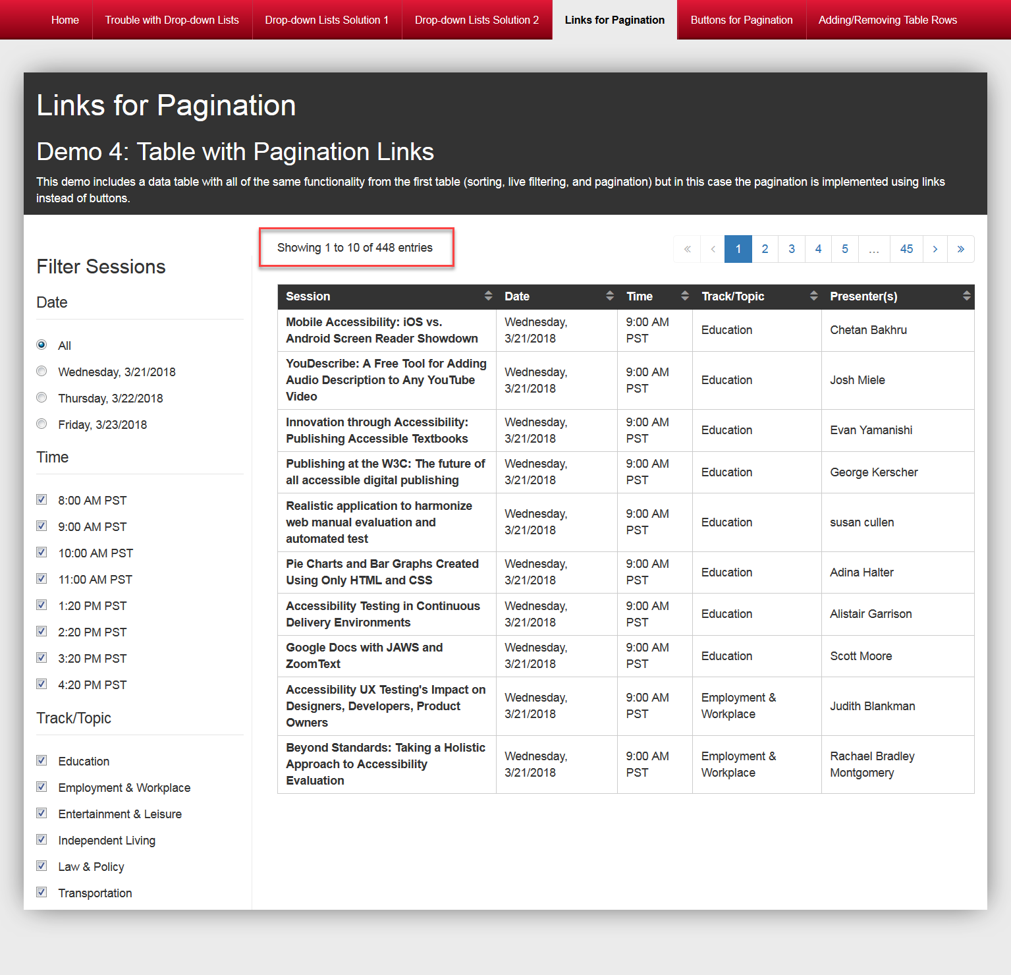
Status Role
The jQuery DataTables library used to create our demos leverages the ARIA status live region role (i.e. role=“status”) to notify AT when a change has occurred to the table that impacts the number of entries being displayed.
The status role is defined on the div containing the “Showing 1 to 10 of 448 entries” text that displays above the table.
Notes:
Sources:
https://www.w3.org/TR/wai-aria-1.1/#status
https://www.w3.org/TR/wai-aria-1.1/#aria-live

Slide 11
Maximizing Status Role Compatibility
The jQuery DataTables library ALSO defines aria-live=“polite” on the div containing the status role.
Technically, the aria-live attribute is redundant since the status role has an implicit aria-live setting of polite. However, if the aria-live attribute is removed, the status is not currently announced in any of our accessibility testing profiles.
The aria-live attribute is used for now to maximize compatibility until there is broader support for the status role across browsers and AT.
Notes:
Source: https://www.w3.org/TR/wai-aria-1.1/#status

Slide 12
Table Scenario 1:
Sorting

Slide 13
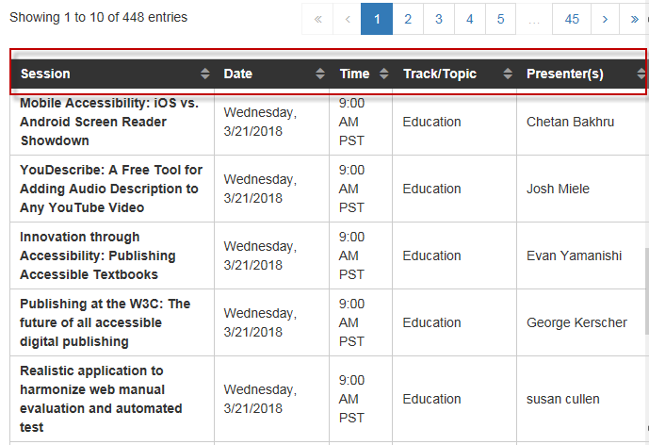
Sorting: Scenario Overview
Sorting is one of the most common interactions available within data tables.
In CGI’s demo, columns that can be sorted are visually distinguished by triangle icons reflecting three states:
Not Sorted (Default)
Sorted Ascending
Sorted Descending

Slide 14
Sorting: Focus Approach
Focus is programmatically set back to the sorting control after it has been activated and a sort has been applied to the data table.
Rationale: The user can then apply another sort on that column, if desired, or navigate to other columns to sort.

Slide 15
Sorting: Live Keyboard Demo

Slide 16
Sorting: Technical Implementation
After a sort control is activated, used JavaScript to programmatically set focus back to the column header that was selected.
Added a custom ARIA live region to notify AT when a column is sorted since the aria-sort property that is defined by the jQuery library is not consistently supported across the accessibility testing profiles we tested with. For example, the live region text for the Session column is either:
“Session column sorted in ascending order” or
“Session column sorted in descending order”
Both the status role and aria-live=“polite” are defined on the div containing the “Showing 1 to 10 of 448 entries” text that displays above the table. As a result, when the user applies a sort, they hear this text announced.

Slide 17
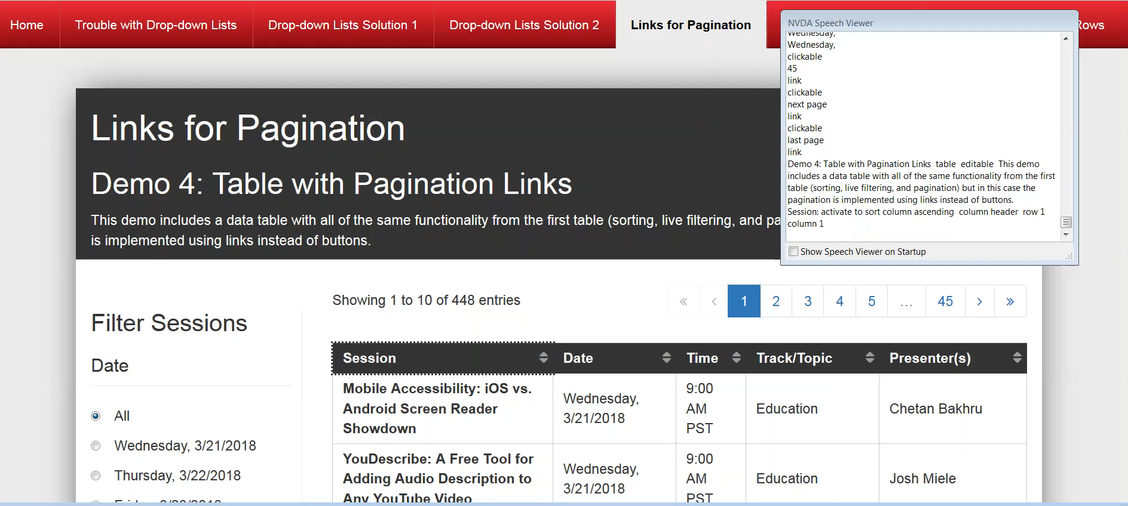
Sorting: Recorded NVDA Demo
Notes:
NVDA announces the following when a column header is sorted: 1) the status live region, 2) the custom live region we implemented (e.g. “Session column sorted in ascending order”), 3) the aria-label for the column header, and 4) the aria-sort property.

Slide 18
Sorting: Browser/AT Testing Results Matrix
Expected Result: Focus is set back to the column header once the sort is applied and the screen reader announces the changed state.
Browser/AT Profile | Testing Result | Notes
NVDA (latest) in Firefox (latest) | Supported | N/A
JAWS 2018 in Internet Explorer 11 | Supported | JAWS does not announce the aria-sort property but it does announce the custom live region CGI implemented, so users are aware of the sort status.
VoiceOver (latest) in Safari (latest) | Supported | VoiceOver only announces the custom live region.
ZoomText in Firefox (latest) | Supported | N/A
Notes:
Table providing the testing results for the sorting table scenario across the 4 targeted accessibility testing profiles we tested with. All 4 profiles supported the expected result in that focus was set back to the column header once the sort was applied and the screen reader announced the changed state. For JAWS 2018 in IE11, the aria-sort property is not announced but the custom live region CGI implemented is announced, so users are aware of the sort status. For VoiceOver in Safari, only the custom live region is announced.

Slide 19
Table Scenario 2:
Pagination

Slide 20
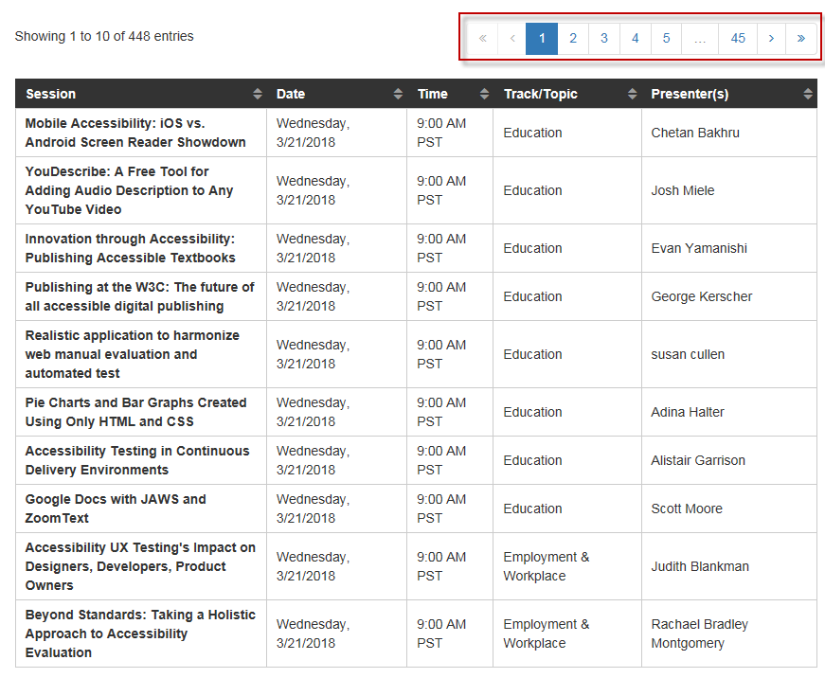
Pagination: Scenario Overview
Pagination is used in data tables to divide large datasets into separate pages.
Pagination is commonly implemented as links but we have seen widgets/design patterns in the past where pagination controls have been implemented as buttons instead.
Our proposed focus management solutions for pagination links vs. buttons are different so we have created two separate demos to cover this:
Links for Pagination
Buttons for Pagination

Slide 21
Table Scenario 2a:
Pagination Links

Slide 22
Pagination Links: Focus Approach
Focus is programmatically set back to the pagination link after it has been selected.
Rationale: The user’s focus is returned to the pagination option they just selected so that they can continue to select pagination options as needed. For example, if the user selected the “Previous Page” link, their focus would return to that link so that they could select the link again if desired.

Slide 23
Pagination Links: Live Keyboard Demo

Slide 24
Pagination Links: Technical Implementation
After a pagination link is selected, used JavaScript to programmatically set focus back to the same pagination element:
If the link is still active, we set focus back to the a tag.
If the link has become inactive, the a tag is replaced with a span and focus is set to the span.
Both the status role and aria-live=“polite” are defined on the div containing the “Showing 1 to 10 of 448 entries” text that displays above the table. As a result, when the user selects a pagination option, they hear this text announced.

Slide 25
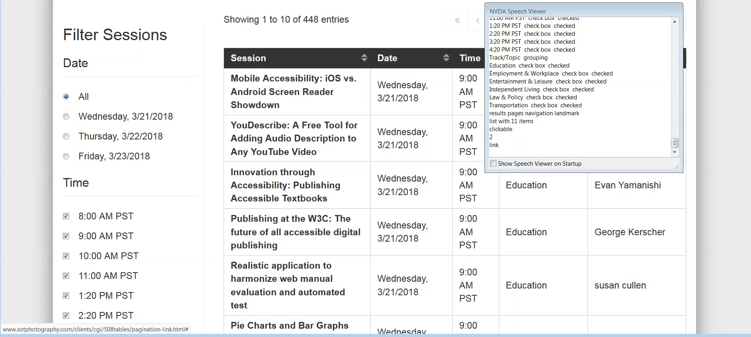
Pagination Links: Recorded NVDA Demo

Slide 26
Pagination Links: Browser/AT Testing Results Matrix
Expected Result: Focus is managed as expected and the screen reader announces the status live region.
Browser/AT Profile | Testing Result | Notes
NVDA (latest) in Firefox (latest) | Supported | N/A
JAWS 2018 in Internet Explorer 11 | Supported | N/A
VoiceOver (latest) in Safari (latest) | Supported | N/A
ZoomText in Firefox (latest) | Supported | N/A
Notes:
Table providing the testing results for the pagination links scenario across the 4 targeted accessibility testing profiles we tested with. All 4 profiles supported the expected result in that focus was managed as expected and the screen reader announced the status live region.

Slide 27
Table Scenario 2b:
Pagination Buttons

Slide 28

Pagination Buttons: Focus Approach
Since focus cannot be set back to a disabled button element in Internet Explorer, we came up with the following focus logic:
If the button has become disabled, set focus to the next active element.
If the button has become disabled and none of the subsequent pagination elements are active, set focus to the first interactive element in the reverse tab order of the pagination control.
If the button is still active, set focus back to the same button (e.g. the previous and next results buttons).
Rationale: Our focus approach balances both the state of the button (i.e. disabled or not) and the next logical place to move the user’s focus.
If I select… | Then focus is set to…
2 | 3
3 | 4
45, >> (last page) | 44
< (previous page) | <
> (next page) | >
Notes:
Table providing examples from CGI's CSUN demo on how focus is managed when a user selects specific pagination buttons. For example, when the 2 button is selected, focus is set to the 3 button. When the 3 button is selected, focus is set to the 4 button. When the 45 or >> (last page) buttons are selected, focus is set to the 44 button. When the < (previous page) or > (next page) buttons are selected, focus is set back to the same button that was selected if they remain active (i.e. there are additional results to review).

Slide 29
Pagination Buttons: Live Keyboard Demo

Slide 30
Pagination Buttons: Technical Implementation
The jQuery DataTables library did not offer a pagination option with buttons so we started with the existing pagination links option and:
Replaced the a tags with button tags
Added the disabled attribute to the button element when it is disabled/inactive.
After a pagination button is selected, used JavaScript to programmatically manage focus.
Both the status role and aria-live=“polite” are defined on the div containing the “Showing 1 to 10 of 448 entries” text that displays above the table. As a result, when the user selects a pagination option, they hear this text announced.

Slide 31
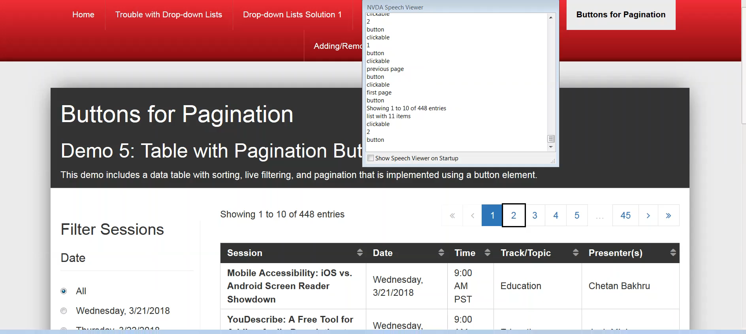
Pagination Buttons: Recorded NVDA Demo

Slide 32
Pagination Buttons: Browser/AT Testing Results Matrix
Expected Result: Focus is managed as expected and the screen reader announces the status live region.
Browser/AT Profile | Testing Result | Notes
NVDA (latest) in Firefox (latest) | Supported | N/A
JAWS 2018 in Internet Explorer 11 | Supported | N/A
VoiceOver (latest) in Safari (latest) | Supported | N/A
ZoomText in Firefox (latest) | Supported | N/A
Notes:
Table providing the testing results for the pagination buttons scenario across the 4 targeted accessibility testing profiles we tested with. All 4 profiles supported the expected result in that focus was managed as expected and the screen reader announced the status live region.

Slide 33
Table Scenario 3:
Live Filtering

Slide 34
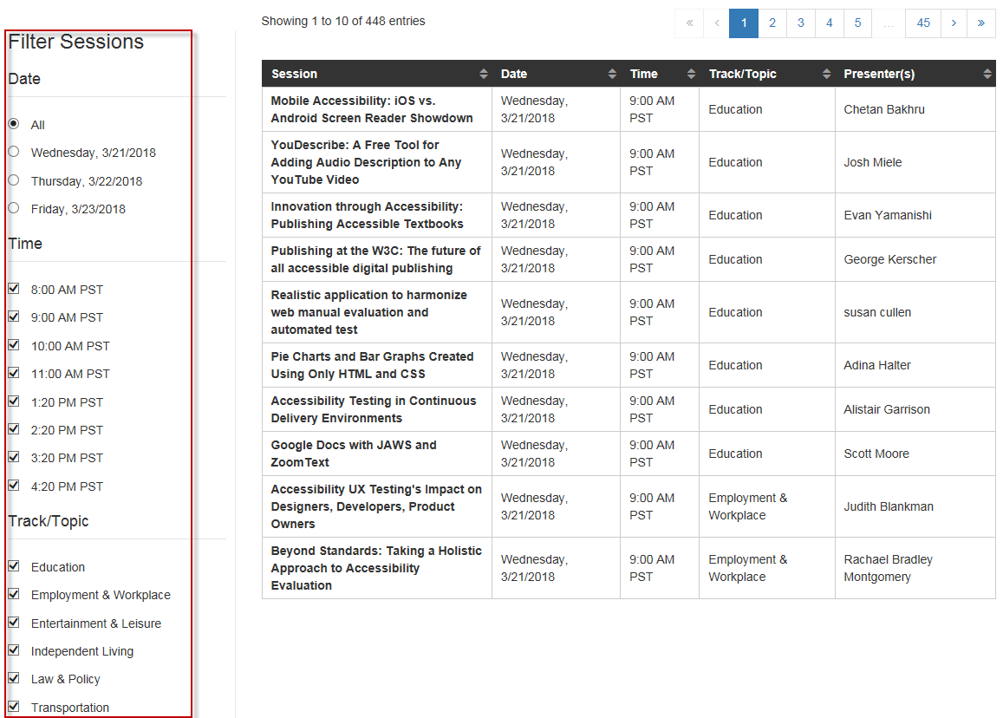
Live Filtering: Scenario Overview
Our demo contains a “Filter Sessions” panel that allows users to filter the results in the data table based on a selection of:
Date radio buttons
Time checkboxes
Track/Topic checkboxes
The filtering is “live” since the table automatically updates as soon as an option is selected.

Slide 35
Live Filtering: Focus Approach
Focus remains on each live filter option after it has been selected and the data table has been updated.
Rationale: There is typically no way to know when the user will be done filtering the contents of the data table and therefore we recommend keeping their focus where it is so that they can continue to filter the results as desired.

Slide 36
Live Filtering: Live Keyboard Demo

Slide 37
Live Filtering: Technical Implementation
After a filter option is selected, used JavaScript to programmatically set focus back to the same filter option.
Even though the filtering controls were custom-coded by CGI, the status live region that is built into the jQuery DataTables widget is still announced since the live filtering causes the results in the data table to change based on the user’s filter selection.

Slide 38

Live Filtering: Recorded NVDA Demo

Slide 39
Live Filtering: Browser/AT Testing Results Matrix
Expected Result: Focus remains on the filtering control that was selected and the screen reader announces the status live region.
Browser/AT Profile | Testing Result | Notes
NVDA (latest) in Firefox (latest) | Supported | N/A
JAWS 2018 in Internet Explorer 11 | Supported | N/A
VoiceOver (latest) in Safari (latest) | Not Supported | The status live region is correctly announced but focus is moved to the data table instead of staying on the selected filter option as expected.
ZoomText in Firefox (latest) | Supported | N/A
Notes:
Table providing the testing results for the live filtering scenario across the 4 targeted accessibility testing profiles we tested with. 3 profiles supported the expected result in that focus remained on the filtering control that was selected and the screen reader announced the status live region. The only exception was VoiceOver in Safar, which did not support since focus was moved to the data table once a live filter option was selected instead of staying on the filter option as expected.

Slide 40
Table Scenario 4:
Adding Data

Slide 41
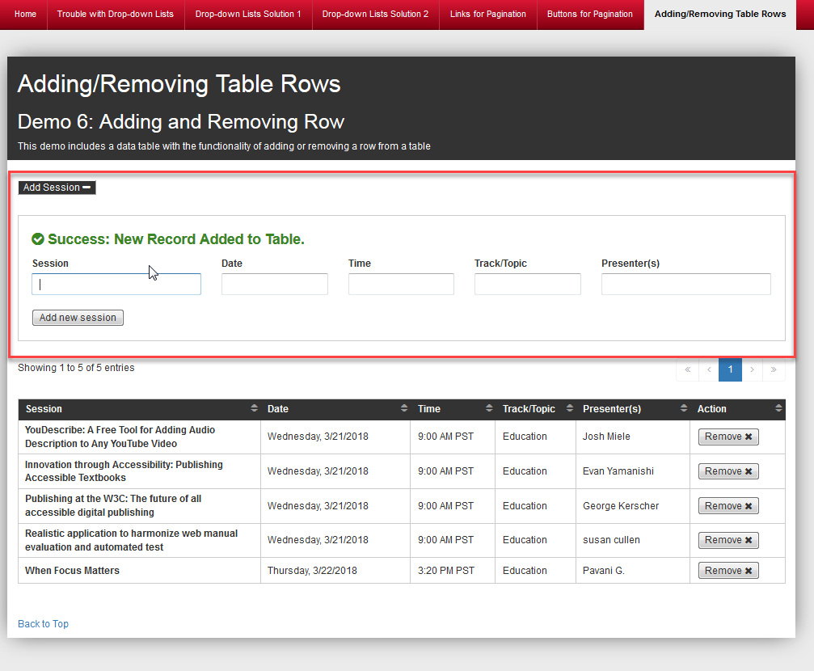
Adding Data: Scenario Overview
Some webpages provide users the option to add their own data into a data table.
In CGI’s demo, an “Add Session” button displays above the table to allow users to add their own session data.
The “Add Session” button acts as an expand/collapse control that dynamically shows/hides form fields to collect the user’s session data.
Selecting the “Add new session” button adds the user’s session data to the table and a message displays at the top of the form confirming that the new session was successfully added.

Slide 42
Adding Data: Focus Approach
Focus stays on the “Add Session” button after it is activated and the panel expands/collapses.
Rationale: The user may wish to expand/collapse the panel multiple times so focus remains on the button. This is also how focus is managed in the Disclosure (Show/Hide) design pattern within the WAI-ARIA Authoring Practices 1.1.
Focus moves to the “Session” field once the “Add new session” button is selected and the user’s data has been added to the table.
Rationale: The user may wish to add several new records to the table so setting their focus back into the first field within the “Add Session” panel allows them to continue data entry as needed. A message is displayed to confirm that the user’s data was successfully added to the table.
Notes:
Source: https://www.w3.org/TR/wai-aria-practices-1.1/#disclosure

Slide 43
Adding Data: Live Keyboard Demo

Slide 44
Adding Data: Technical Implementation
Used JavaScript to programmatically manage focus.
Used aria-expanded to control the state change of the “Add Session” button.
Defined the alert role on the div containing the “Success: New Session Added” text that displays after a new session is added so that this information is conveyed to AT users.
The alert role is a type of live region containing important, and usually time-sensitive, information.
An alert is similar to a status live region except that it has an implicit aria-live value of assertive instead of polite.
Notes:
Source: https://www.w3.org/TR/wai-aria-1.1/#alert

Slide 45
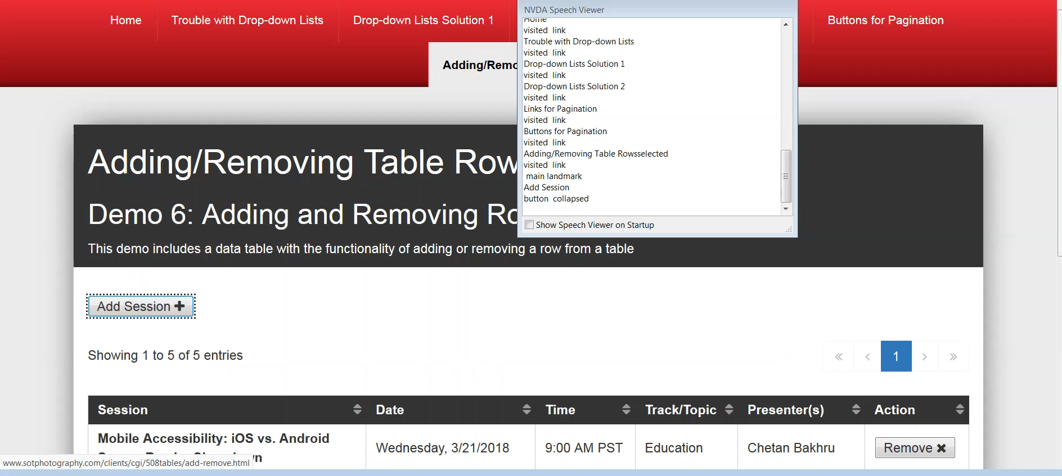
Adding Data: Recorded NVDA Demo

Slide 46
Adding Data: Browser/AT Testing Results Matrix
Expected Result: Focus is managed as expected and the screen reader announces both the status and alert live regions.
Browser/AT Profile | Testing Result | Notes
NVDA (latest) in Firefox (latest) | Supported | N/A
JAWS 2018 in Internet Explorer 11 | Supported | N/A
VoiceOver (latest) in Safari (latest) | Partially Supported | Focus is managed as expected. The status live region and the role of alert are not announced.
ZoomText in Firefox (latest) | Supported | N/A
Notes:
Table providing the testing results for the adding data scenario across the 4 targeted accessibility testing profiles we tested with. All 4 profiles supported the expected result in that focus was managed as expected and the screen reader announced the status and alert live regions. The only exception wasa VoiceOver in Safari, which managed focus as expected but did not announce either of the live regions.

Slide 47
Table Scenario 5:
Removing Data

Slide 48
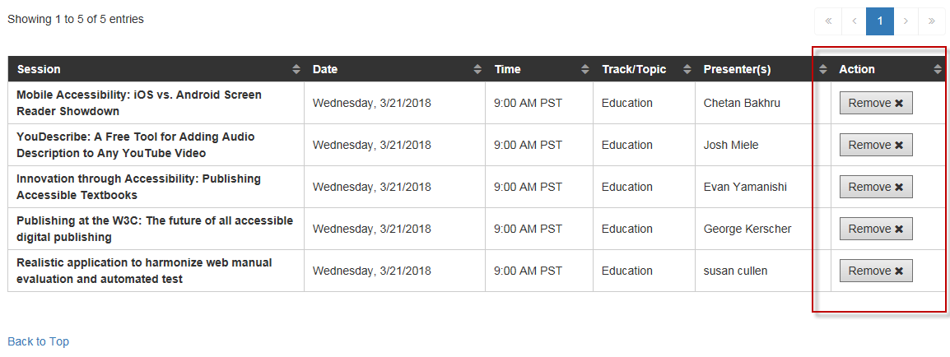
Removing Data: Scenario Overview
Some webpages allow user’s to remove/delete data within a table.
In CGI’s demo, each row within the data table can be removed using the “Remove” button that displays within the Action column.

Slide 49
Removing Data: Focus Approach
After the “Remove” button is activated:
Focus is set to the next interactive control in the following row.
Unless the removed row was the last in the data table, in which case focus is set to the last interactive element in the previous row.
If the user has deleted the last row in the table and the table is now empty, focus is set to the next interactive element on the page (after the data table).
Rationale: Our focus approach considers the next logical place to move the user’s focus since the control the user has just activated (i.e. the “Remove” button) is no longer on the page.

Slide 50
Removing Data: Live Keyboard Demo

Slide 51
Removing Data: Technical Implementation
Used JavaScript is to programmatically manage focus.
Defined a custom ARIA live region to notify AT when a row is removed. The live region text is “[Session Name] has been removed.”
The status live region that is built into the jQuery DataTables widget is announced since removing the data causes the results in the data table to change.

Slide 52
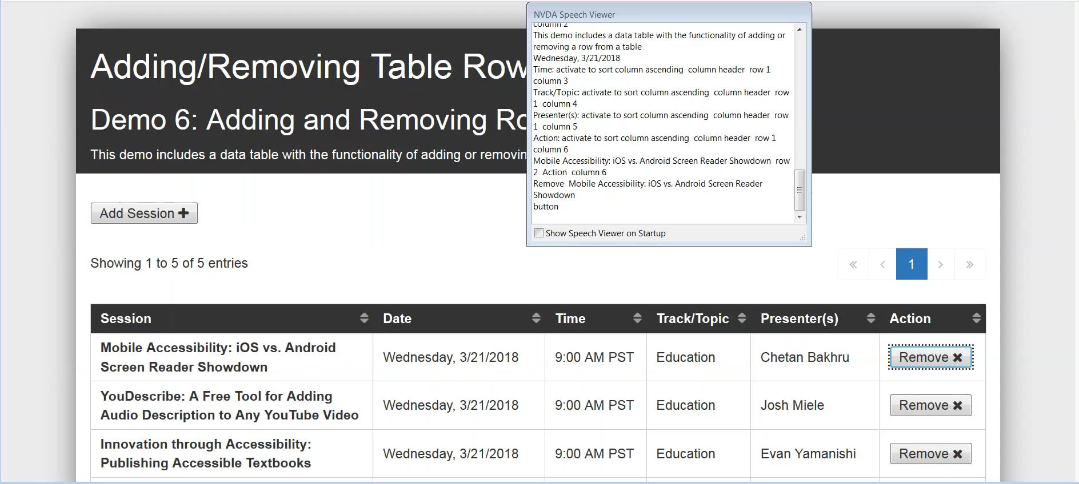
Removing Data: Recorded NVDA Demo

Slide 53
Removing Data: Browser/AT Testing Results Matrix
Expected Result: Focus is managed as expected and the screen reader announces both the status and custom live regions.
Browser/AT Profile | Testing Result | Notes
NVDA (latest) in Firefox (latest) | Supported | N/A
JAWS 2018 in Internet Explorer 11 | Supported | N/A
VoiceOver (latest) in Safari (latest) | Partially Supported | Focus is managed as expected and the custom live region is announced. The status live region is not announced.
ZoomText in Firefox (latest) | Supported | N/A
Notes:
Table providing the testing results for the removing data scenario across the 4 targeted accessibility testing profiles we tested with. All 4 profiles supported the expected result in that focus was managed as expected and the screen reader announced the status and custom live regions. The only exception was VoiceOver in Safari, which managed focus as expected but did not announce the status live region (only the custom live region).

Slide 54
Wrap-Up

Slide 55
Custom CGI Enhancements to jQuery DataTables Widget
Added JavaScript to manage programmatic focus
Defined the scope attribute for the column headers
Added a custom ARIA live region to notify AT when a column is sorted since aria-sort is not consistently supported across the accessibility testing profiles we tested with. For example, the live region text for the Session column is either:
“Session column sorted in ascending order” or
“Session column sorted in descending order”

Slide 56
Custom CGI Enhancements to jQuery DataTables Widget (Continued)
Pagination:
Added an aria-label to the <<, <, >, and >> links to provide a meaningful accessible name (e.g. “previous page”).
Added the ARIA role=“navigation” landmark to the div containing the pagination links with an aria-label of “results pages” so that AT users can easily navigate between the pagination and other parts of the page using landmark keyboard shortcuts.
Added the aria-current=“page” attribute to the active/selected pagination option since it is visually styled to indicate it is the currently-displayed page.

Slide 57
Useful Articles and References
How to Meet WCAG 2.0: https://www.w3.org/WAI/WCAG20/quickref/
WAI-ARIA 1.1 Recommendation: https://www.w3.org/TR/wai-aria-1.1/
WAI-ARIA Authoring Practices 1.1: https://www.w3.org/TR/wai-aria-practices-1.1/
W3C Web Accessibility Tutorials - Tables Concepts: https://www.w3.org/WAI/tutorials/tables/

Slide 58
Administrative Wrap-Up
Slides: You can access our slides and demos here: https://tinyurl.com/csunatc18-cgi
Questions after the session? Contact us at:
Elizabeth Whitmer, @BethMWhitmer elizabeth.whitmer@cgifederal.com
Pavani Gonuguntla, @PavaniS508 pavani.gonuguntla@cgifederal.com
Development Credit: Special thanks to CGI developer Sot Kiep for developing all the working demos for this session!

Slide 59
Questions?

